Slide 1


Experimental Study of Trajectory Generation for Delta Parallel Robot
Arvin Mohammadi
Dr. Mohammad Reza Haeri Yazdi
Dr. Mehdi Tale Masouleh
1

Slide 2
01
Introduction
Experimental Study of Trajectory Generation for Delta Parallel Robot
Trajectory Planning
2

Slide 3
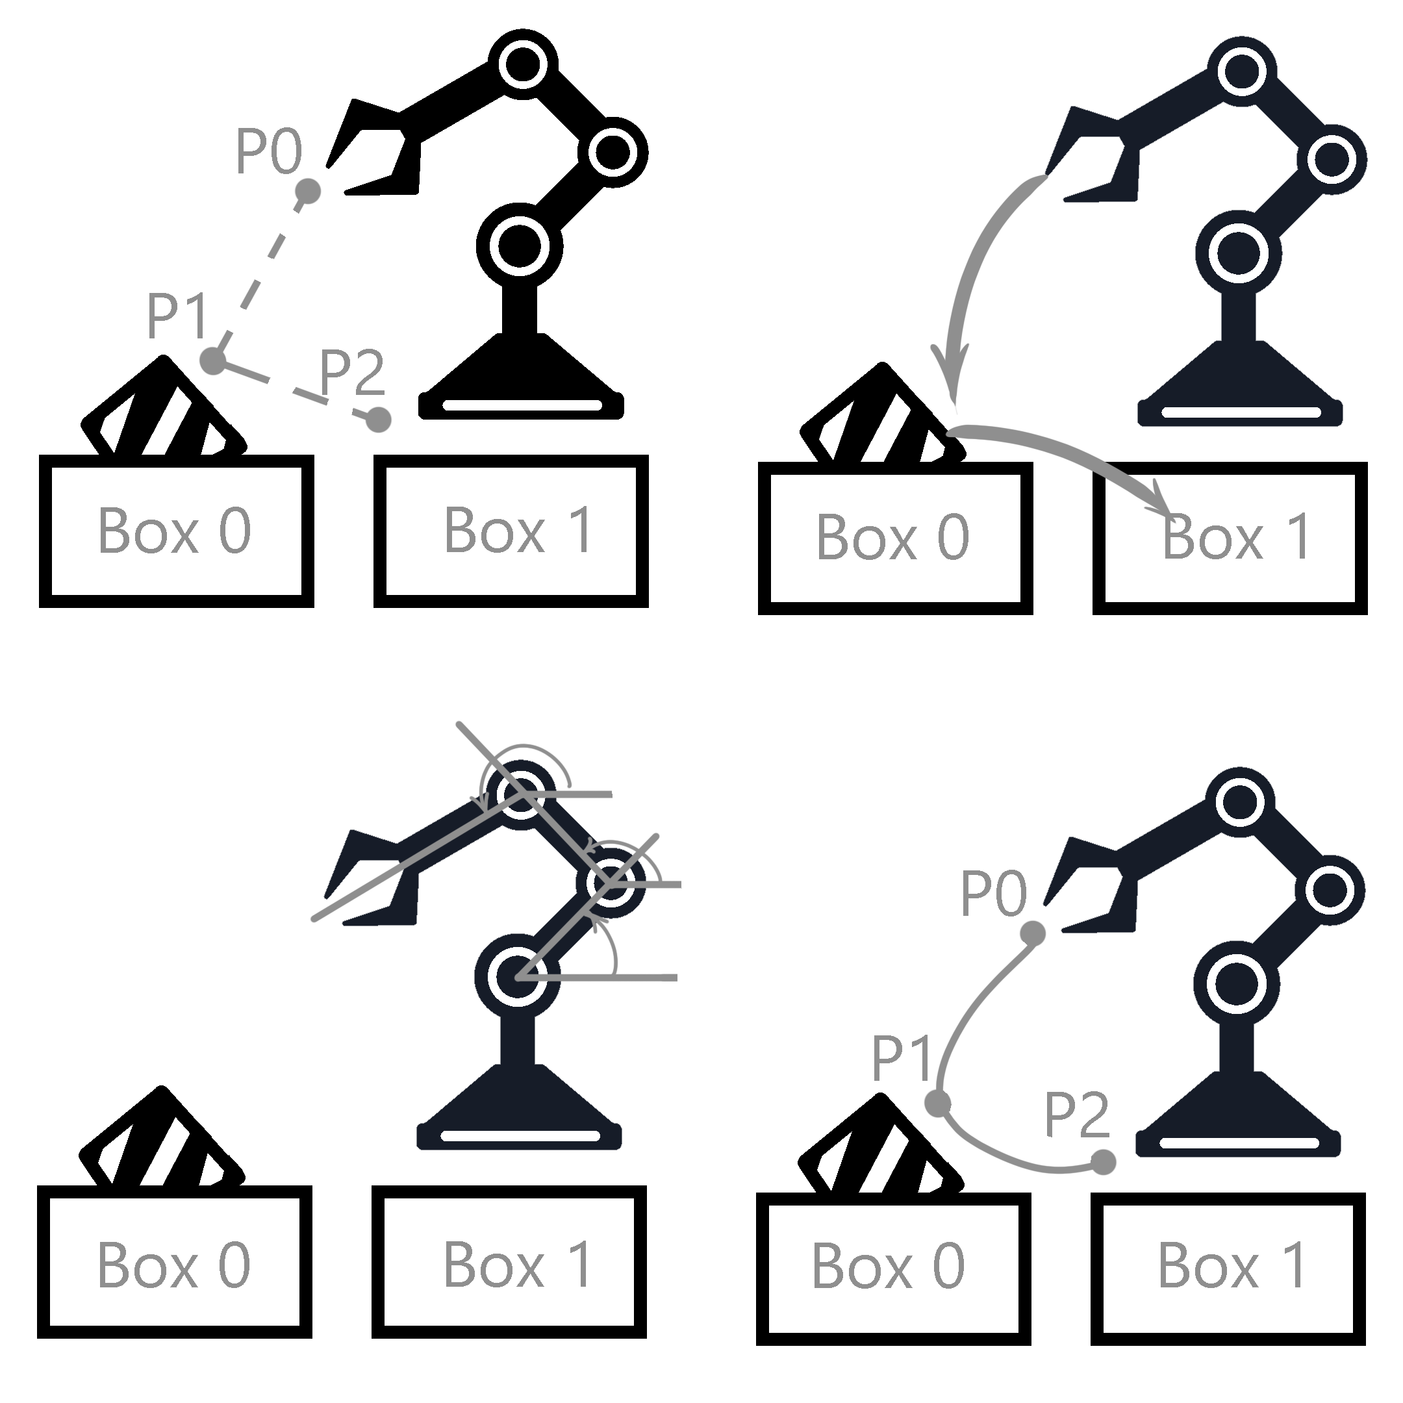
Experimental Study of Trajectory Generation for Delta Parallel Robot
Trajectory Planning
3

Slide 4
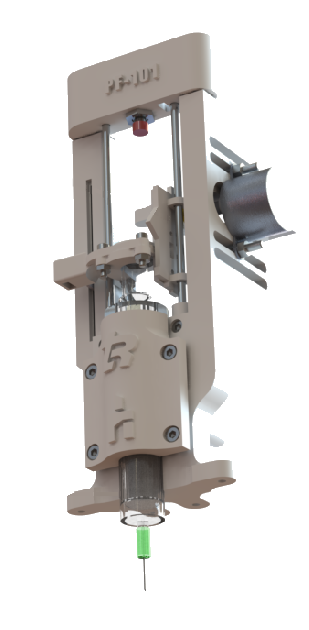
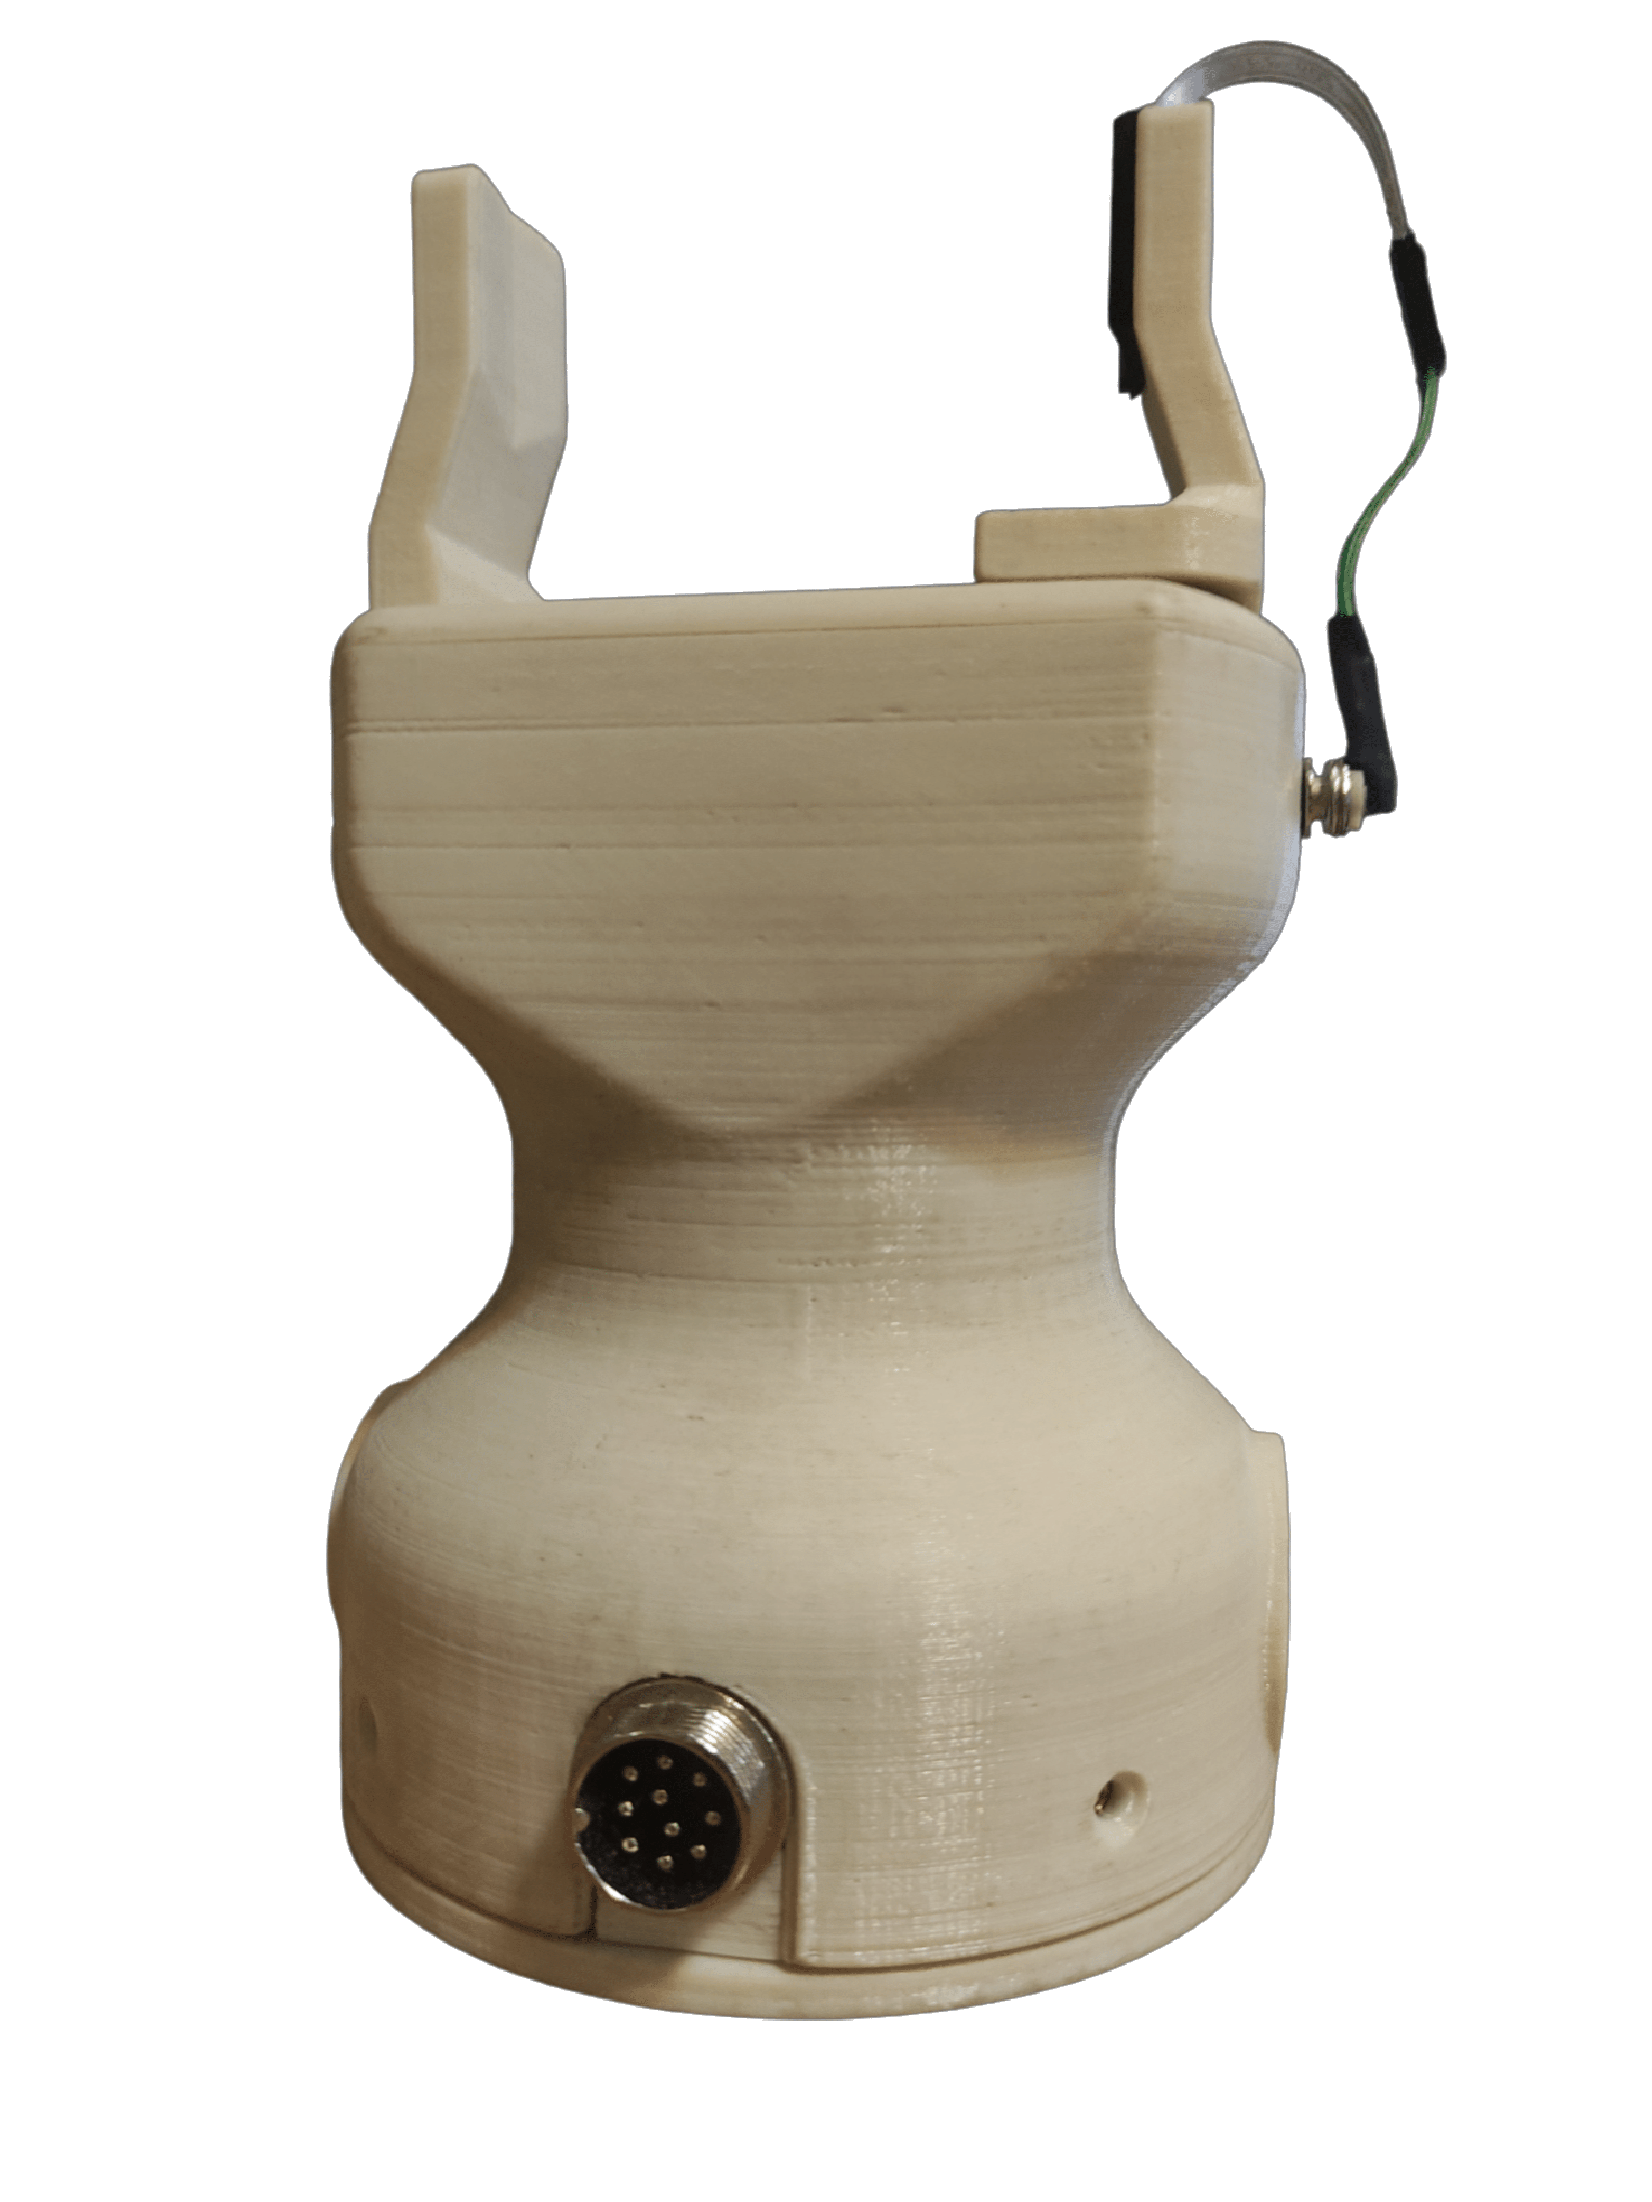
Delta Robot Setup
Experimental Study of Trajectory Generation for Delta Parallel Robot
4

Slide 5
02
Industrial Applications
Experimental Study of Trajectory Generation for Delta Parallel Robot
Published IEEE Papers
5

Slide 6
Experimental Study of Trajectory Generation for Delta Parallel Robot
Published IEEE Papers
Published
Experimental Study on the Pick-and-place Operation of a 3-DOF Delta Parallel Robot
Experimental Study on Autonomous Food Packaging with Delta Parallel Robot and Two Fingered Gripper
Generating a General Culturing Microorganism Pattern Using a Delta Parallel Robot and Cam-in-Hand Calibration Method
Work in Progress
Experimental Study on Automated Pipette-Filling Using Delta Parallel Robot and Randomized Tube-Rack Placement
Experimental Study of Delta Parallel Robot Trajectory Generation and Obstacle Avoidance
6

Slide 7
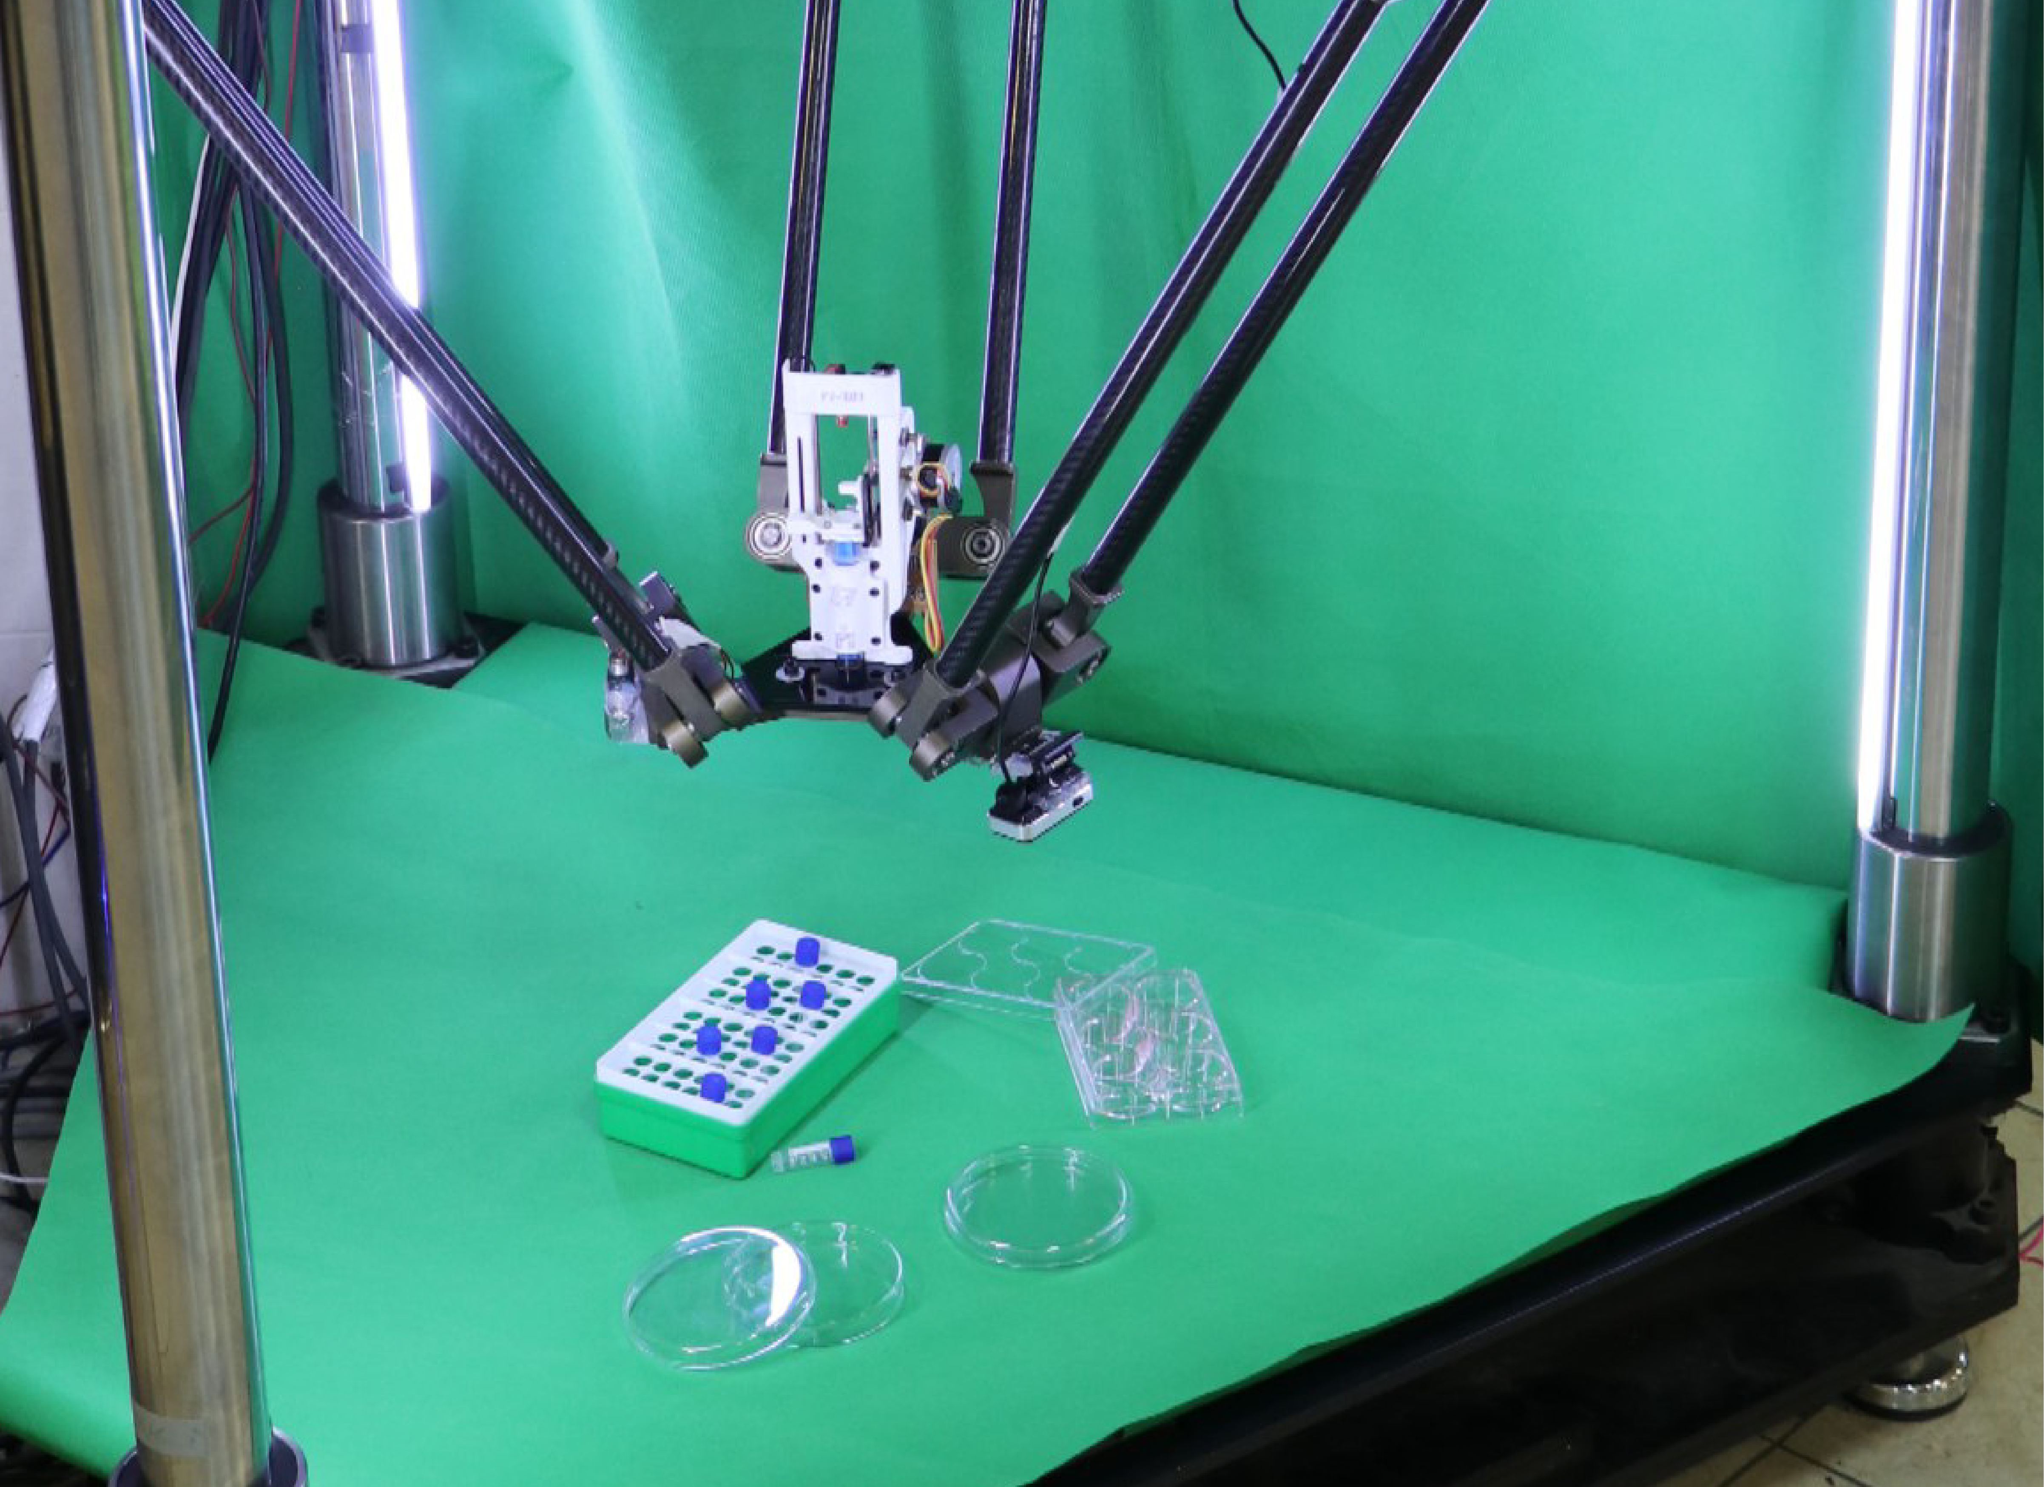
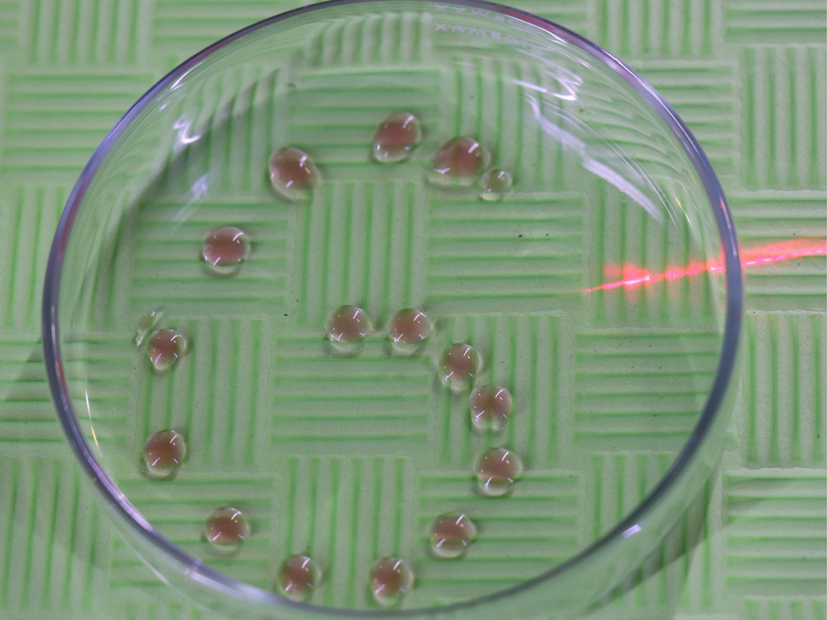
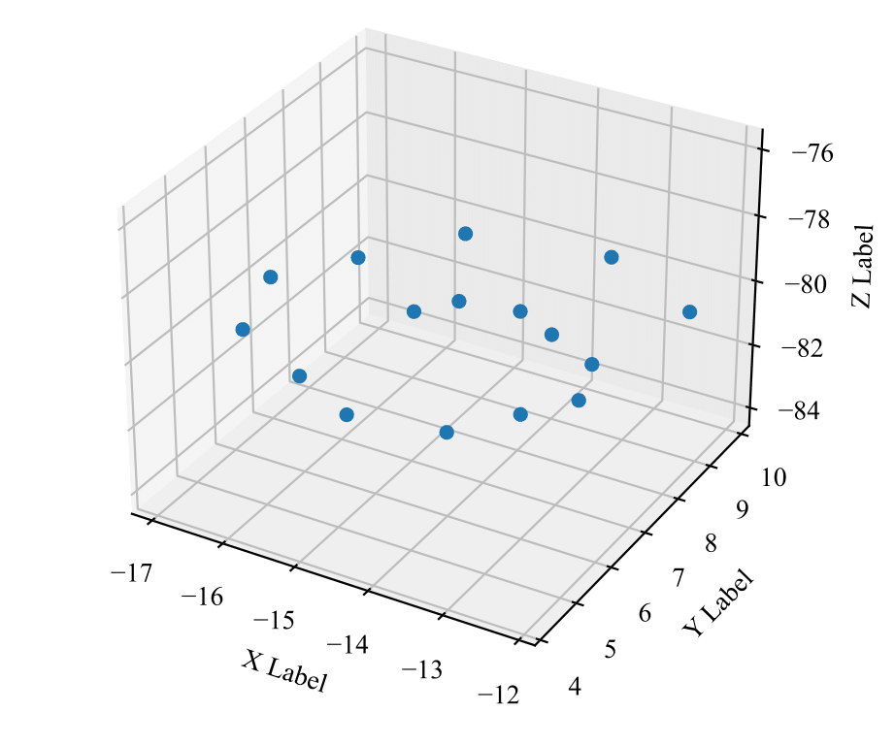
Petri-dish & Pipette filler
Experimental Study of Trajectory Generation for Delta Parallel Robot
Method(s) Used:
Point-to-Point 5th Order Polynomial
Point-to-Point 7th Order Polynomial
7

Slide 8
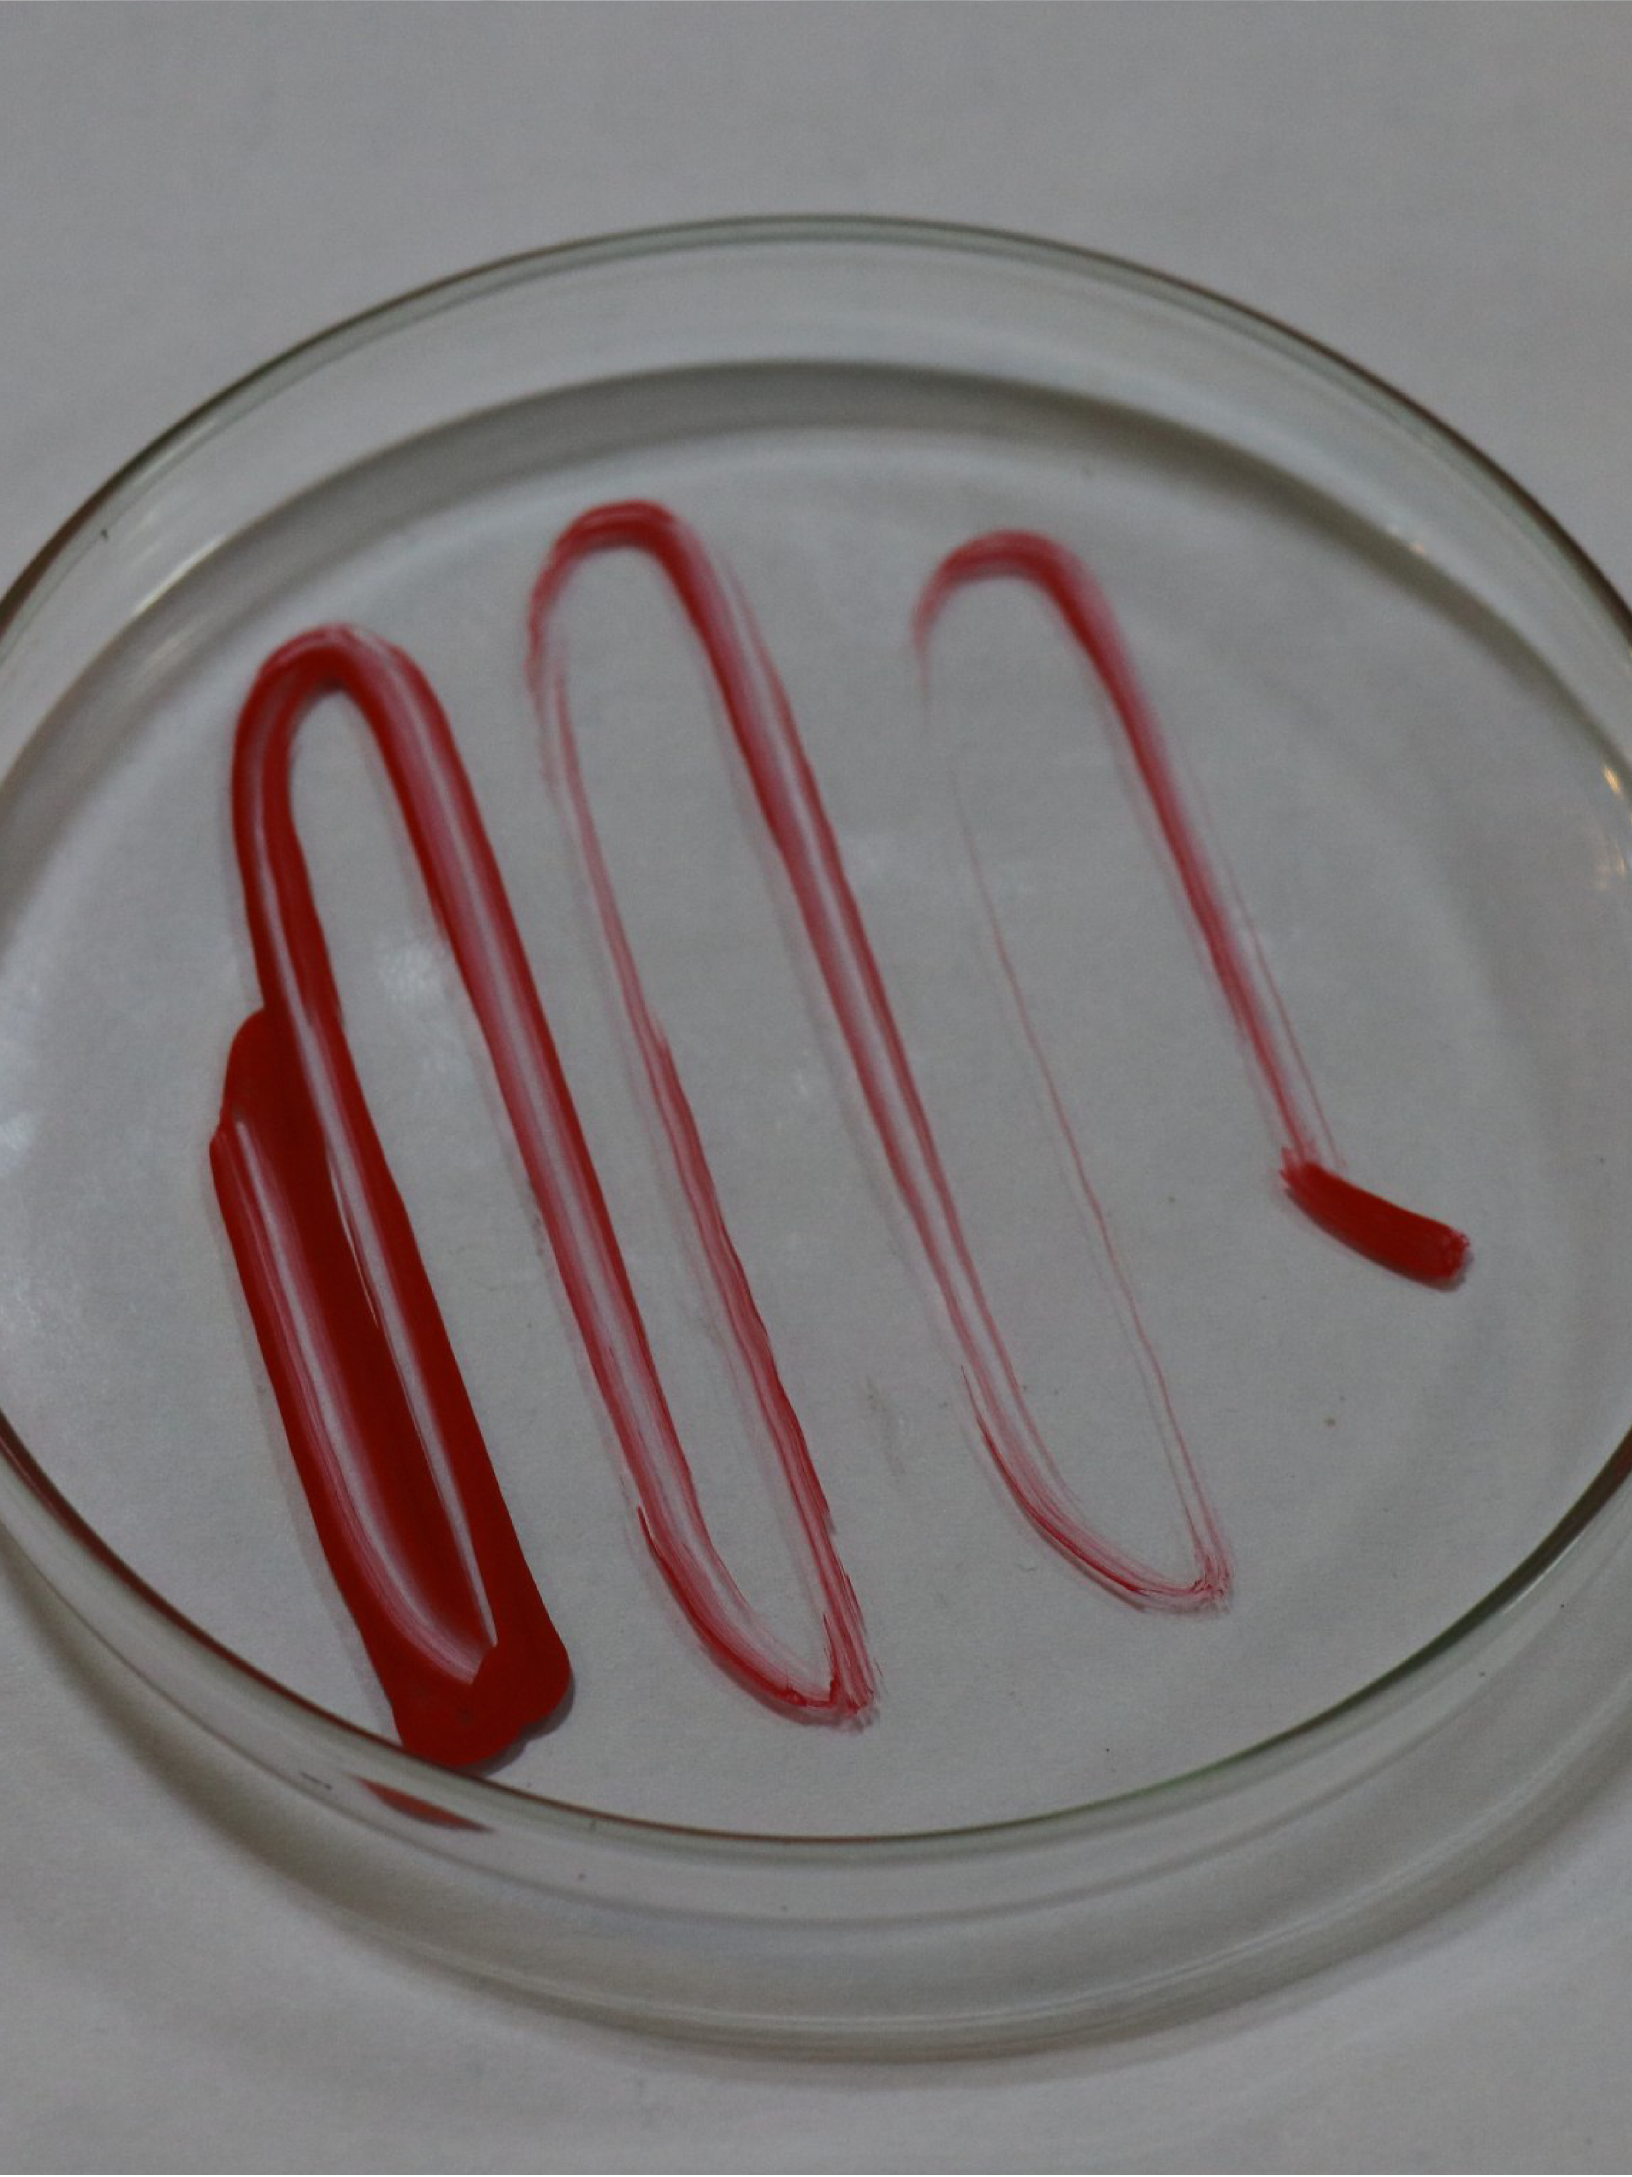
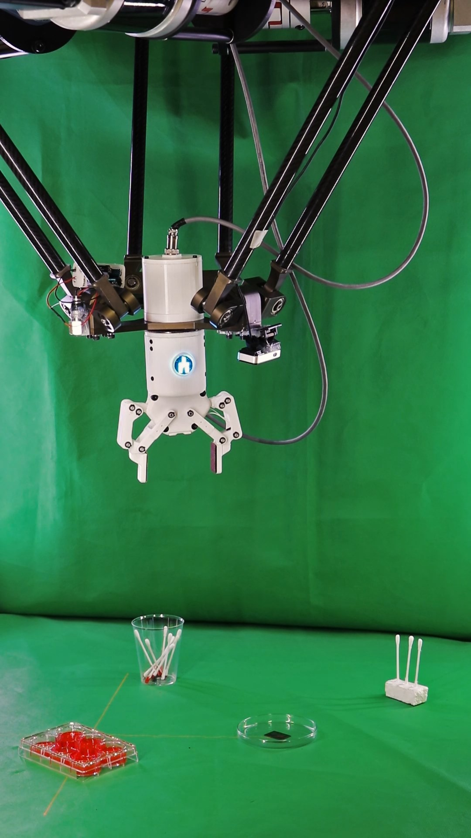
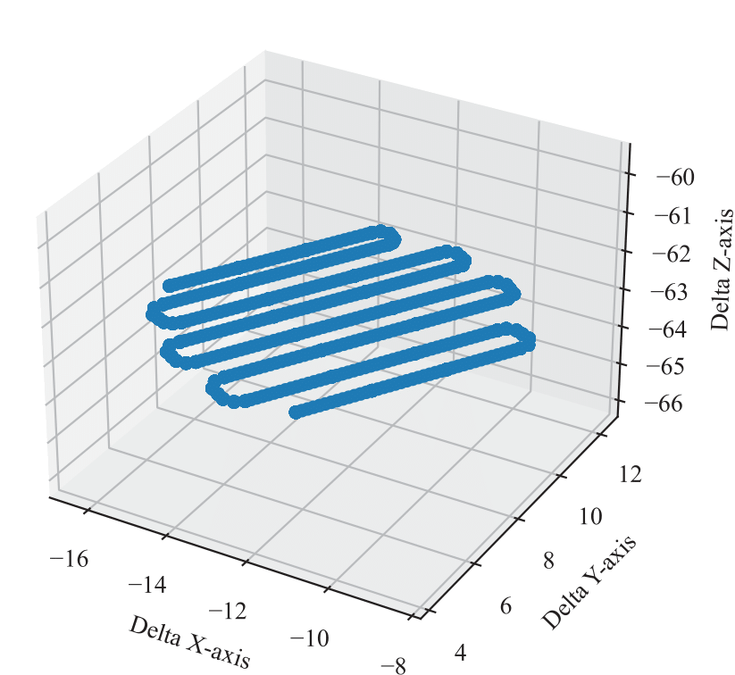
Petri-dish & Swab
Experimental Study of Trajectory Generation for Delta Parallel Robot
Method(s) Used:
Pattern Generation
8

Slide 9
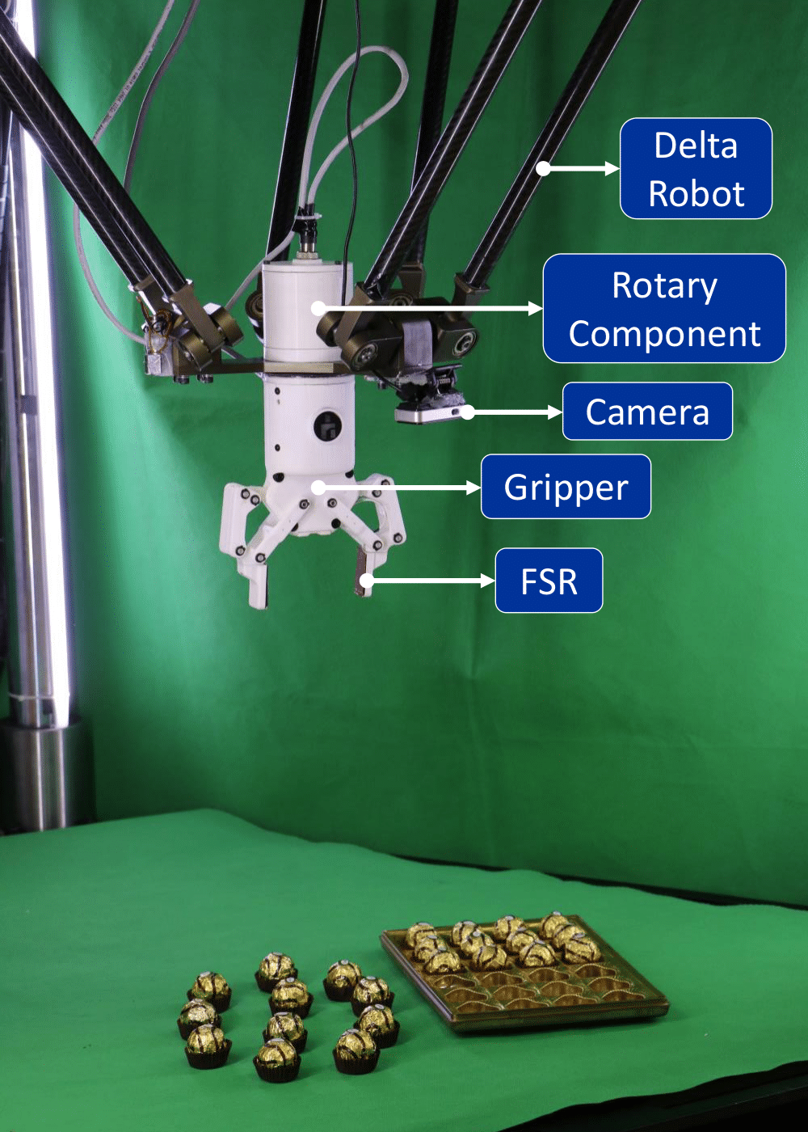
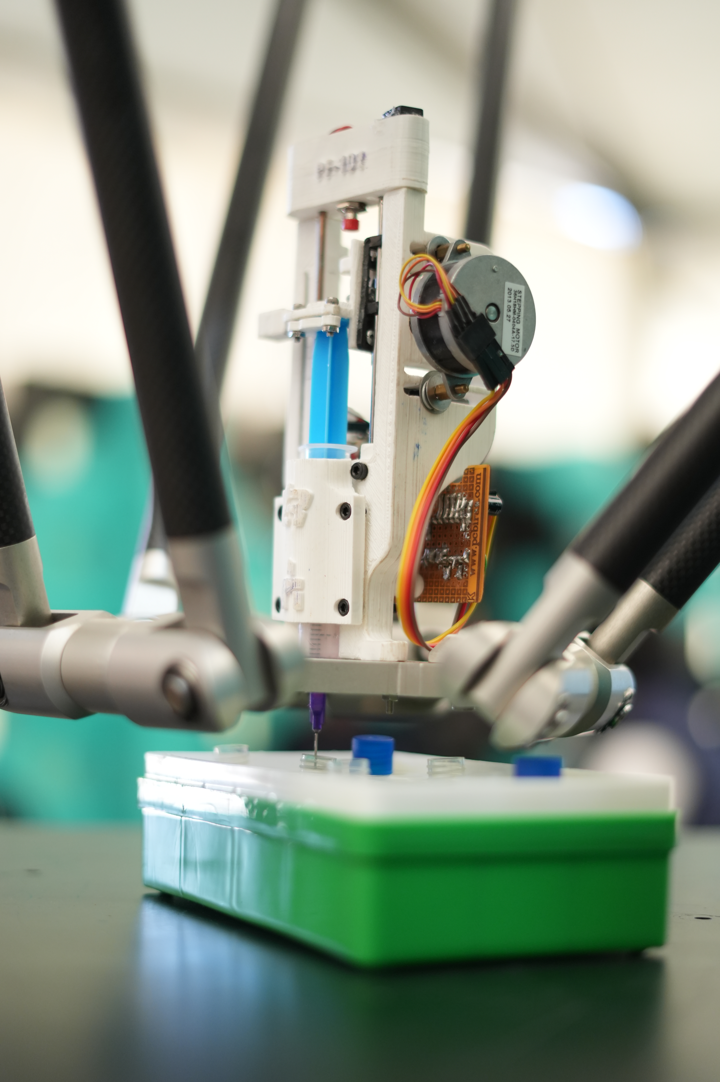
Test Tube Filling & Food Packaging
Experimental Study of Trajectory Generation for Delta Parallel Robot
Method(s) Used:
A Combination of Point-to-Point
Movement and Adept Cycle
9

Slide 10
03
Results & Analysis
Experimental Study of Trajectory Generation for Delta Parallel Robot
Adept Cycle Implementation
10

Slide 11
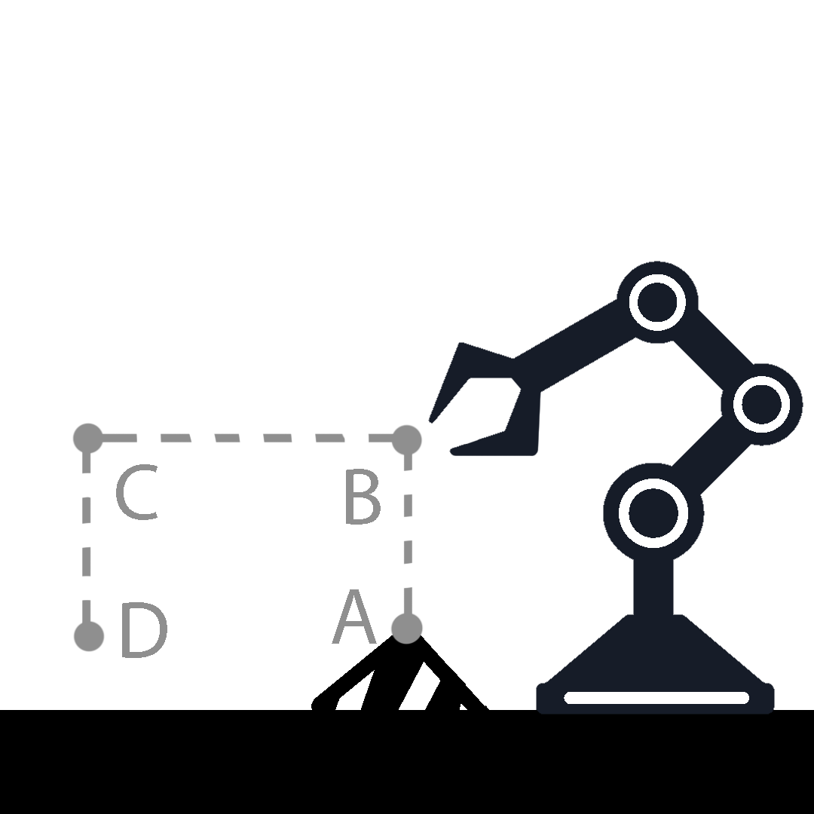
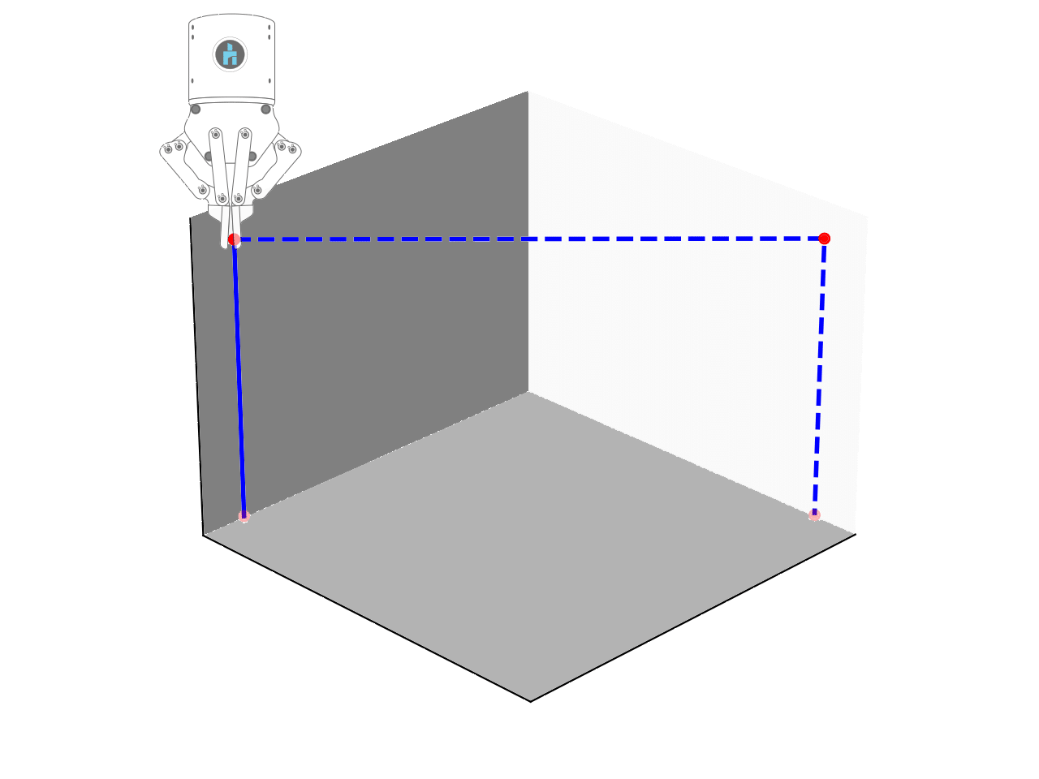
Experimental Study of Trajectory Generation for Delta Parallel Robot
Adept Cycle Implementation
11

Slide 12
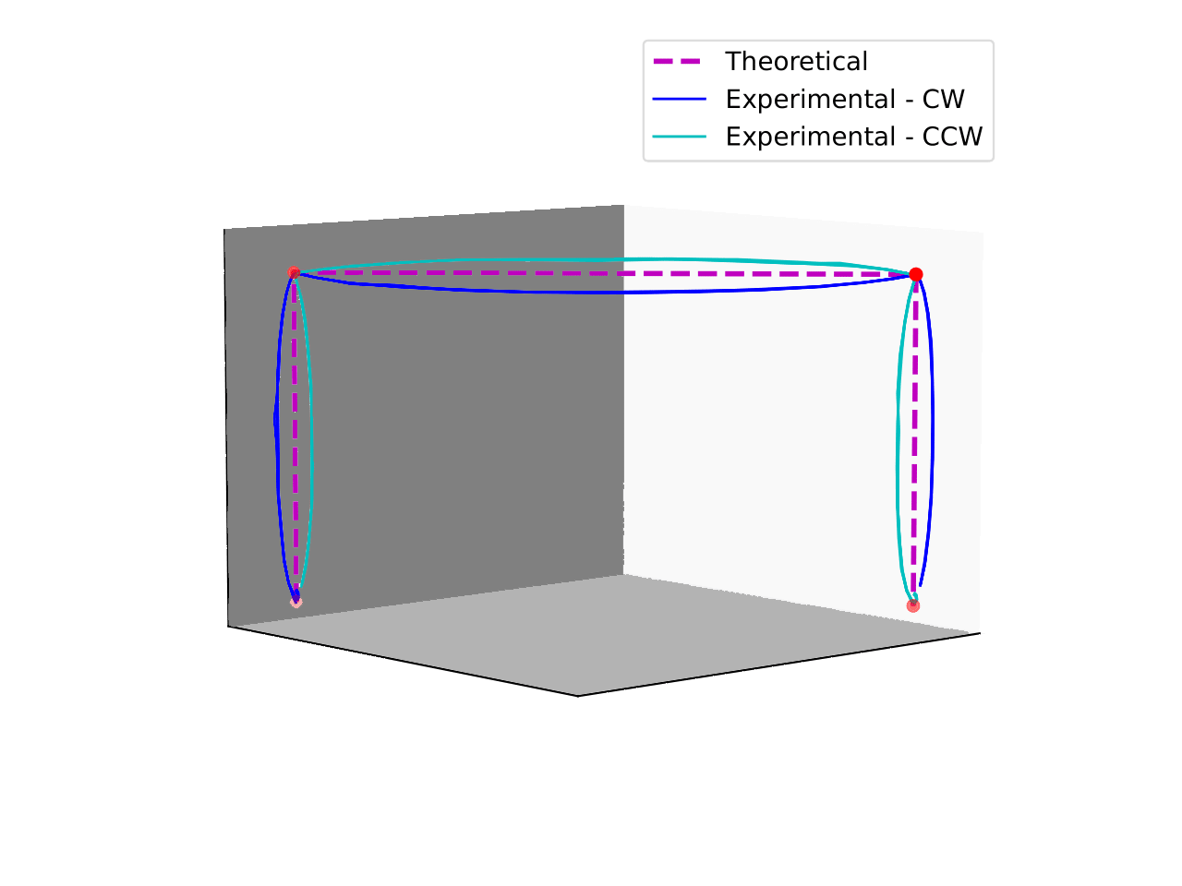
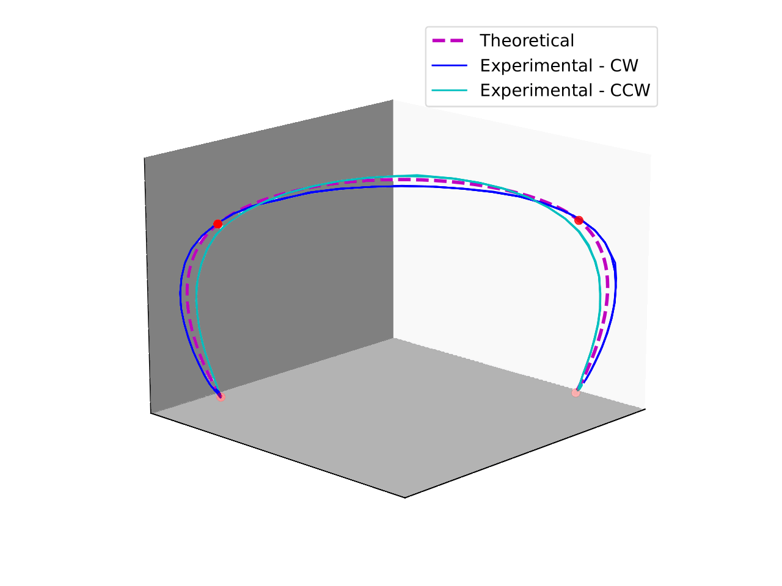
Experimental Study of Trajectory Generation for Delta Parallel Robot
Point-to-Point Methods
Multi-Point Methods
12

Slide 13
Methods Used
Point-to-Point Methods
Multi-Point Methods
Parabolic
Trapezoidal
S-Curve
Polynomial 5th, 7th, and 9th Degree
Cubic Spline
Polynomial 7th, 9th, and 11th Degree
13

Slide 14
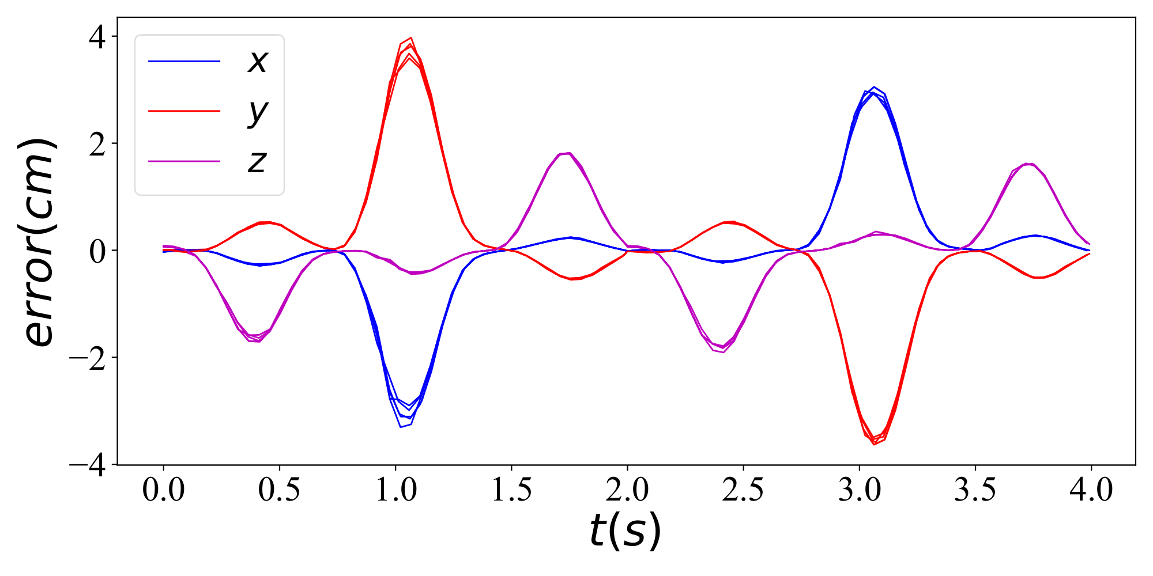
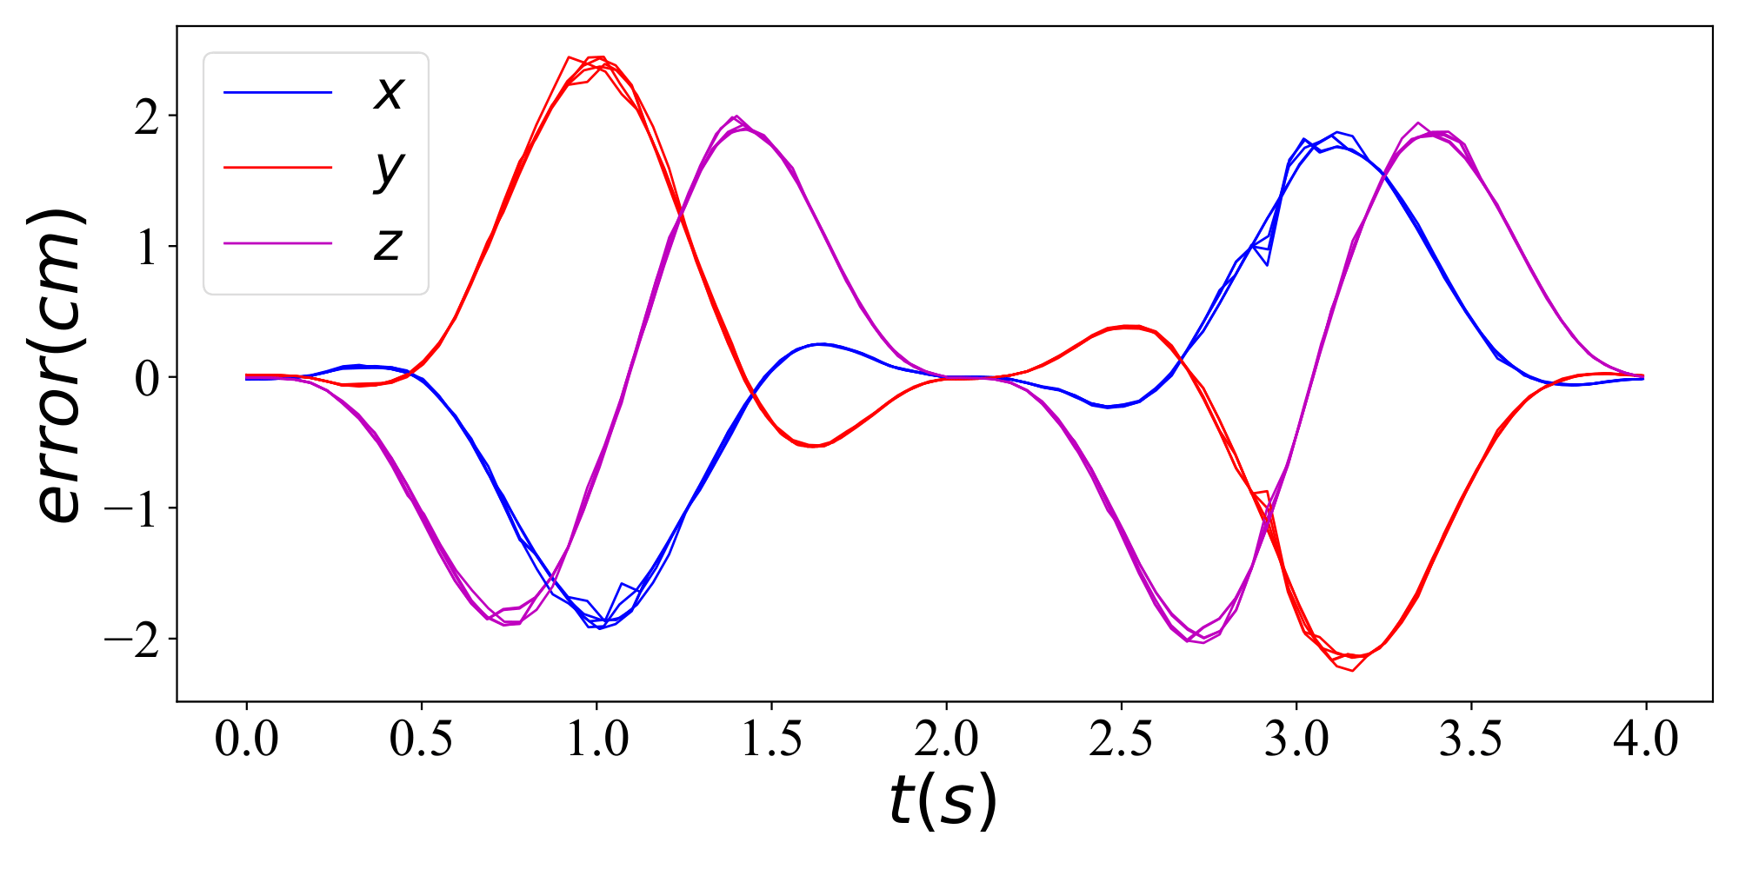
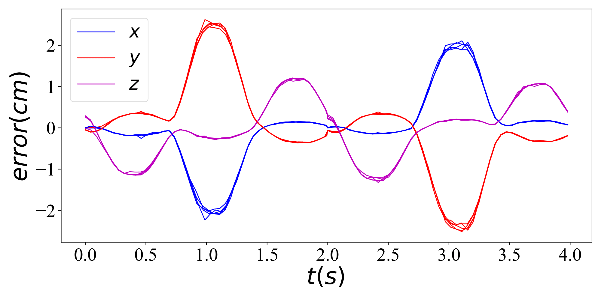
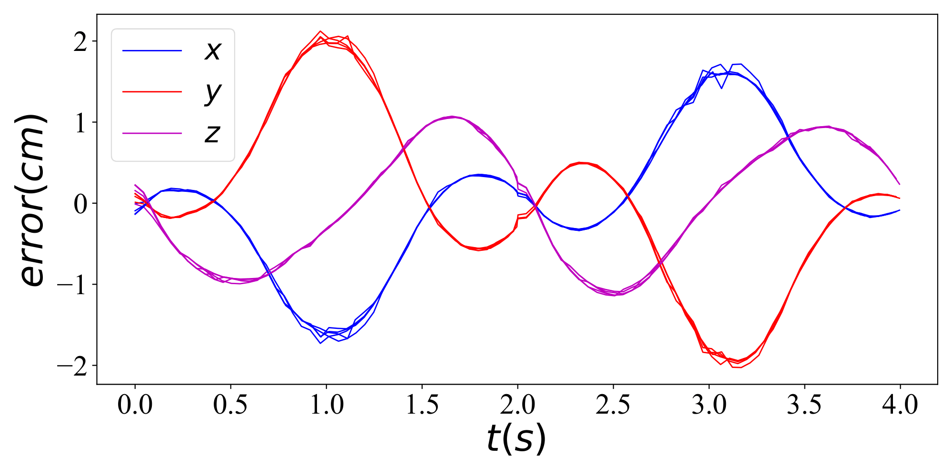
Experimental Study of Trajectory Generation for Delta Parallel Robot
Polynomial 9th Degree – Point to Point
Polynomial 11th Degree – Multi Point
Trapezoidal – Point to Point
Cubic Spline – Multi Point
14

Slide 15
Experimental Study of Trajectory Generation for Delta Parallel Robot
Final Error Values – Point to Point Trajectories
Trajectory/Time | 2 Seconds | 3 Seconds | 6 Seconds
Parabolic | 4 mm | 0.306 mm | 0.094 mm
Trapezoidal | 4.4 mm | 0.296 mm | 0.094 mm
S-Curve | 3.2 mm | 0.165 mm | 0.019 mm
5th Order Polynomial | 3.4 mm | 0.158 mm | 0.020 mm
7th Order Polynomial | 2.2 mm | 0.114 mm | 0.019 mm
9th Order Polynomial | 1.6 mm | 0.073 mm | 0.022 mm
16

Slide 16
Experimental Study of Trajectory Generation for Delta Parallel Robot
Final Error Values – Multi Point Trajectories
Trajectory/Time | 2 Seconds | 3 Seconds | 6 Seconds
Cubic Spline | 3.1 mm | 0.277 mm | 0.062 mm
7th Order Polynomial | 1.1 mm | 0.079 mm | 0.036 mm
9th Order Polynomial | 0.4 mm | 0.036 mm | 0.023 mm
11th Order Polynomial | 0.2 mm | 0.034 mm | 0.023 mm
15

Slide 17
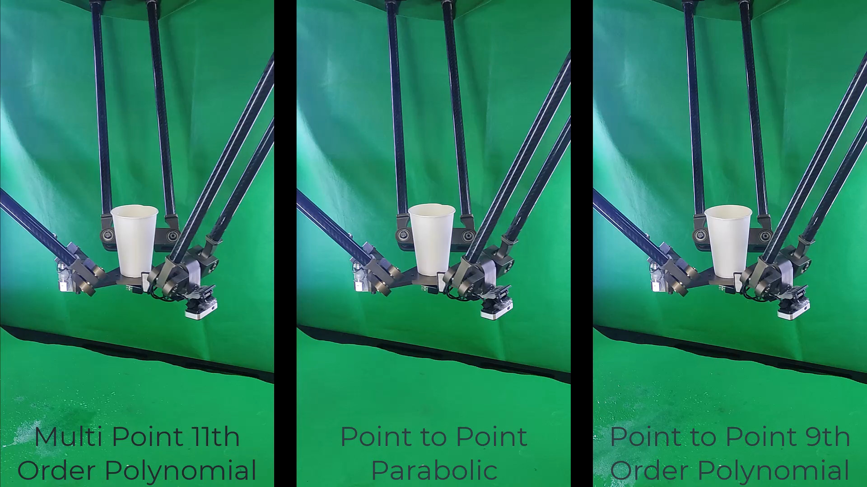

Slide 18

Thanks!

